Slide 1
RC BOT

Slide 2
A robot WITHOUT A MICRO-CONTROLLER
An RF transmitter and receiver module coupled with HT12E and HT12D.
This transfers the data over the air to the motor driver L293D.

Slide 3
THINGS WE NEED?
DC GEARED MOTORS
WHEETLS
METTALIC CHASSIS
L293D MOTOR DRIVER IC
DPSD SWITCH
HT12E – ENCODER IC
HT12D – DECODER
RF Rx-Tx MODULE
9V BATTERY PACK (2)
BOT
REMOTE CONTROLLER

Slide 4
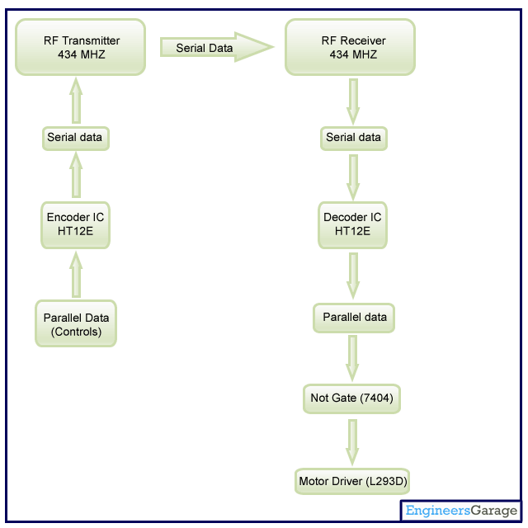
SO, how does it work
Two main logic blocks.
Transmitter and Receiver.

Slide 5
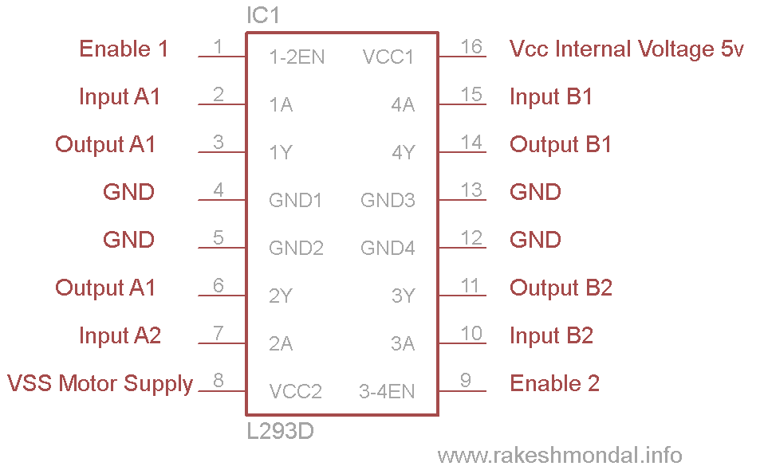
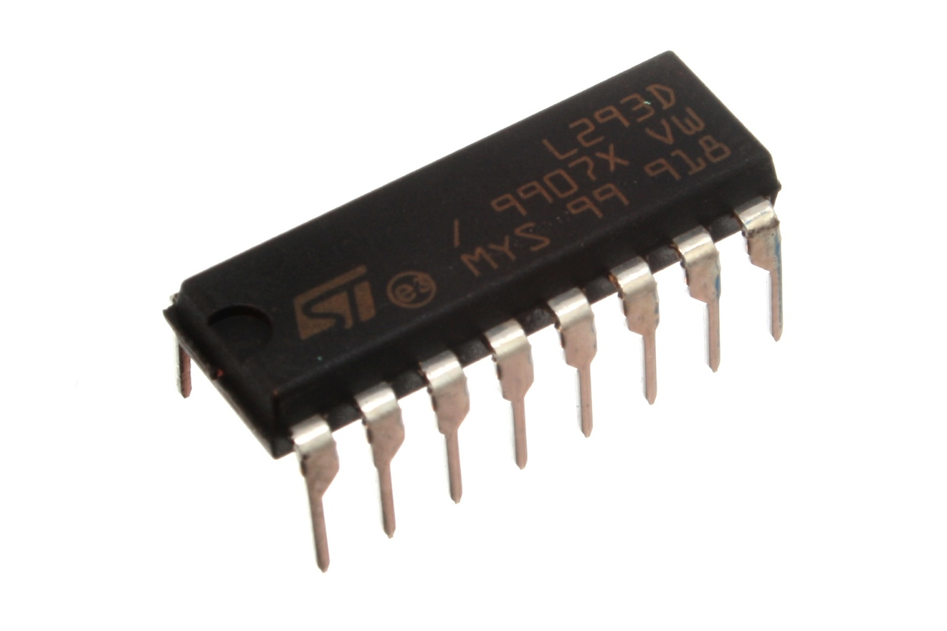
Motor driver l293D
L293d is a dual H-bridge motor driver to be short
It drives the motor in both forward and backward directions.
It is a 16 pin which can control two geared DC motors simultaneously.

Slide 6
HT12e Encoder
It is an Encoder integrated circuit of 2^12 series of encoders.
Converts parallel inputs into serial output.

